Slide 1
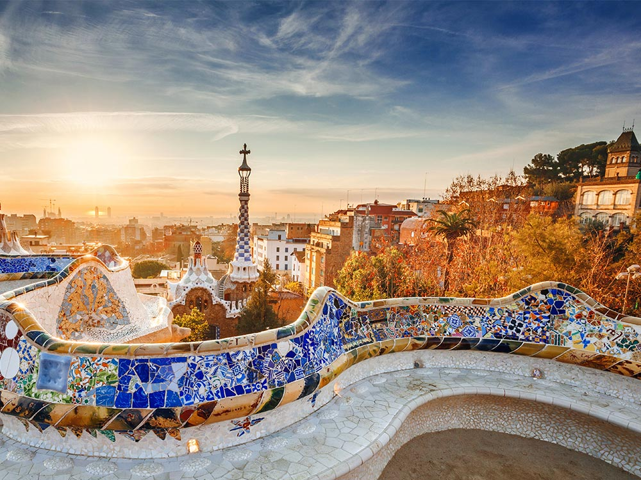
ALAC-GAC Meeting

Slide 2
New gTLD – An Experiment
Who do you think would really need new gTLDs?
What did new gTLDs change in the consumers daily lives?
How to ensure a fair and equal access to new gTLDs?

Slide 3
ALAC-GAC Joint Statement
GDPR

Slide 4
Thank You

